Slide 1
Managing Information Technology Resources ITWS 4310
Social Media
November 12, 2018

Slide 2
Managing IT Resources Class Outline: Mon, Nov 12, 2018
MITR Term Project
Schedule Meetings with Client and Invite Faculty to Meetings
Work on Design and Development
Draft of Entire Term Project Final Report on Nov 19 by 9 PM
Final Presentations on Dec 6 and Dec 10
All Teams Submit Final Reports on Dec 10
All Students Grade and Rank all Presentations by Dec 11
All Students Complete Peer Evaluations of Their Team by Dec 11
Quiz
Current Event Articles
Chapter 9: Social Media, Peer Production and Leveraging the Crowd
Chapter 10: The Sharing Economy, Collaborative Consumption and Efficient Markets through Tech
Facebook Case on Thurs, Nov 15

Slide 3
Randomly Assigned Final Presentation Schedule
Thursday Dec 6
Team 5
Team 2
Team 4
Monday Dec 10
Team 3
Team 1
Team 6
Invite your Clients to attend your class presentation and any or all of the other presentations on the two days.
In Addition, offer to present in a longer format (~ 1 hour) at the Client’s Location or on a Video Link to the Client’s Location.
If your Client cannot attend the day scheduled, but could on the other day, let us know and we will try to accommodate.
Presentations will be 15 minutes long with 5 minutes for Q&A. Time will be monitored and you will be given visual warnings at 3, 2, 1 minutes respectively.

Slide 4
Managing IT Resources ITWS 4310-01 Term Project Final Presentations
10-15 minutes for presentation and demo
5 minutes for Q&A
All team members present and participating
Business Attire
Invite Clients to Presentation
All students grade and rank other presentations

Slide 5
Suggestions for Oral Presentations
Be prepared: know the material well
Be prepared: practice with other team members and before a live audience
Introduce self and team
One person in front of audience at one time – others “off stage” to side
Tell audience what you are going to cover verbally or in an agenda
Display energy and engagement
Display good posture
Speak clearly and loudly enough so that you can be heard throughout the room
Move your head and body to speak to all parts of the room
Make direct eye contact with audience members in various parts of the room
Use gestures to emphasize points and to point to some particularly important aspects of the visuals. Do not use so many gestures that it is distracting.
Keep your hands out of pockets or other parts of clothing
Use transitions to new presenter – introduce next presenter – next presenter says “Thanks xyz” and start with strong first sentence
Summarize at end of section and end of presentation – strong conclusion
Plan the time to be taken by each presenter. Remember transition times. Practice for timing. Keep within time allotted.
Prepare the slides so that they are visually attractive, communicate key points, have good flow, are “branded” for the particular talk, are of sufficiently large font that they can be read from the back of the room
Practice, practice, practice!

Slide 6
Evaluate the Performance of each Team Member on the Term Project (Score from 1-10 with 1 being poor and 10 being excellent)
Team Members | Self | Other Team Member 1 Enter Name Below | Other Team Member 2 Enter Name Below | Other Team Member 3 Enter Name Below
Evaluation Criteria/ Names
Contribute to the ideas for the team project
Attend and actively participate in team meetings
Contribute by being a good team leader
Contribute by being a good listener and team follower
Provide deliverables to team on time as committed
Contribute to the planning and organization of the project
Contribute to the technical aspects of the project
Contribute to the writing and presentation of the project
Contribute fair share of the overall workload to the project
Overall contribution to the team project
Total

Slide 7
Managing IT Resources: ITWS 4310 Term Project Report Outline
Section 1: Executive Summary
Section 2: Introduction
Section 3: Client Organization and Description
Section 4: Project Team
Section 5: Problem Statement
Section 6: IS/IT Solution
Section 7: Methodology
Section 8: IS/IT Requirements
Section 9: IS/IT Design
Section 10: Cost-Benefit Analysis with (Risk Mgmt)
Section 11: Project Plan/Schedule/Resources
Section 12: Post-Turnover Plan
Section 13: Results and Client Feedback
Section 14: Conclusions
All Sections of Final Report in Draft due by Nov 19 (Mon before Thanksgiving) at 9 PM

Slide 8
Managing IT Resources: ITWS 4310 Term Project Report Outline
Section 1: Executive Summary
Should be able to “stand on its own”
Provides an “executive” overview of the entire project
What are the important points that an executive would need to know?
The best summaries effectively balance details with a concise writing style

Slide 9
Managing IT Resources: ITWS 4310 Term Project Report Outline
Section 2: Introduction
Keep it short – 2-3 sentences
Only 2 objectives: provide a little context for the project and pique interest to read on
Section 3: Client Organization and Description
Give some idea of the size of the organization: number of employees, number of locations, etc.
Include Client Contact name and contact information
Section 6: IS/IT Solution
If solution has changed throughout semester, make reference to the original solution concept and then describe current/latest solution concept
Section 7: Methodology
Brief description of how each major aspect of project was done e.g. a cost benefit analysis focused on NPV and IRR was used to assess financial viability of the project. Don’t’ be repetitive with subject section
Cover project/client selection, requirements, development methodology, financial viability, project management, implementation methodology, and client feedback method

Slide 10
Managing IT Resources: ITWS 4310 Term Project Report Outline
Section 8: IS/IT Requirements
Categorize both Functional and Non-Functional Requirements
Section 9: IS/IT Design and Development
Use-Case Summary (part of narrative) and Use-Case Diagram
Work Flow Diagram (logic that connect back-end with front-end)
Back-end Design including Data Work Flow and Database Design
Front-end Design including Mock-ups, Wireframes, Screen Shots
Working System including link to working system or prototype
Access to Code in Code Repository
Test Plan(s) and Test Results
Narrative of All Design and Development
Section 10: Cost Benefit Analysis with Risk Management
Combine the Excel Sheets for CBA and Risk Management into one Excel Workbook
Combine the CBA and Risk Management into one Narrative

Slide 11
Managing IT Resources: ITWS 4310 Term Project Report Outline
Section 11: Project Management/Resource/Schedule
Specify reference to separate Gantter project plan
Include screenshot showing entire project in report
Summary of major project phases including the duration, work effort, costs for each phase. Can be organized into a summary table
Section 12: Post-Turnover Plan
Installation
Training
Documentation
Future support and maintenance plan

Slide 12
Managing IT Resources: ITWS 4310 Term Project Report Outline
Section 13: Results and Client Feedback
Specify what functionality was delivered when
Results showing that the System meets the “Requirements” or not
Client Feedback
Section 14: Conclusions
What were the “lessons learned” by the team
What worked well
What didn’t work well
What would you do differently “next time”
Cover team dynamics, client dynamics, and technology

Slide 13
DO’S - Draft MITR Final Project Report
Submit the draft with all sections completed
Use the “Outline” as provided in the Project Assignment
Write an “Executive Summary” that covers all of the key qualitative and quantitative points from the project in up to 2 pages. Think of it as an entirely separate document.
Write or rewrite all of the sections as of the end of the Project (current situation, verb tenses)
Write in the “Third Person” throughout the Report; i.e. “The Team”, “The Client”, not “I”, “We”, “Our”.
Integrate the whole report as a single narrative (make it flow, consistent style, don’t repeat, don’t leave out material)
Proofread for grammar, spelling, consistent style and formatting
Include Gantter Project Plan. Include text in the report to explain.
Include CBA sheet and Risk Management sheet in single Excel Workbook Include text in the report to explain.

Slide 14
DON’TS - Draft Final Project Report
Simply paste together the milestone assignments.
They were written at different times and the verb tenses are not correct for the Final Report.
They were written at different times and they may not flow and integrate well as a single narrative.
They were written for various purposes that may not be appropriate for the Final Report, e.g., team description may be too detailed on your team member’s backgrounds.
Leave out the “Results and Conclusions” since you are not be finished. Include the results and conclusions written as if the project has been completed. It’s ok at this point to infer. You will adjust this accordingly for the final report.

Slide 15
Quiz!
10 Questions, 10 Minutes

Slide 16
Technology Current Events: “Google Walkout organizers: changes are a start, but not enough”, Engadget, November 9, 2018. https://www.engadget.com/2018/11/09/google-walkout-response/
The 20,000 participants who took part in the Google Walkout for Real Change successfully compelled the company to rethink practices related to sexual harassment.
In a note to employees, Google CEO Sundar Pichai said the company will no longer force workers to go into arbitration. Further, he promised greater transparency on sexual harassment reports, as well on how the company handles them.
As the movement's organizers note, though, Google's response overlooked several of their core demands, particularly those meant to address the systemic racism and discrimination within the company. "Sexual harassment is the symptom, not the cause. If we want to end sexual harassment in the workplace, we must fix these structural imbalances of power," they wrote in response to Pichai's message.
The organizers are asking Google to give the chief diversity officer more power, and they're also asking for an employee representative on the board. They're demanding more benefits for contract workers -- who are "largely people of color, immigrants and people from working class backgrounds" -- that make up half of the company, as well. However, it sounds like the organizers are going to meet with Google leadership to hash things out and to work on trying to get the company meet all their demands.

Slide 17
Technology Current Events: “Netflix is shoring up its defenses for when it loses Disney content”, Yahoo Finance, November 8, 2018. https://finance.yahoo.com/news/netflix-shoring-defenses-loses-disney-230201716.html
Disney, in its fourth-quarter earnings report on Thursday, revealed the official name of its forthcoming subscription streaming service: Disney+. Disney+ is coming in 2019, and will boast a bevy of exclusive content from Disney Animation, Marvel, Pixar, and Lucasfilm. It could be very attractive to parents, especially, with Disney family content they won’t be able to find on any other service. And Netflix knows it.
It’s no coincidence that Netflix this week announced a buffet of forthcoming original animated shows and movies, set for release through 2022. The titles include original series and movies, many of them with big names attached.
Netflix says 60% of its members watch kids or family content each month. But 68% of Netflix subscribers who have young children are not aware that Disney content will be pulled from Netflix come 2019, according to Business Insider research. When those parents fire up Netflix one day in late 2019 and suddenly can’t find the Disney content they want, will they drop Netflix?
Disney has not yet shared the Disney+ subscription price, but we do know it will be south of $10 per month, after Iger said on an earnings call last year that Disney’s plan is, “to price this substantially below where Netflix is,” though that is also, “reflective of the fact that it will have substantially less volume.”
Critics have harped on that last point—that Disney+ will not have a large library of content at launch—but a laundry list of big releases that Iger rattled off in August on Disney’s third-quarter earnings call still raised eyebrows: “Captain Marvel,” “Dumbo,” “Avengers 4,” “Aladdin,” “Toy Story 4,” “Artemis Fowl,” Disney’s live-action “Lion King,” “Jungle Cruise,” “Frozen 2,” and “Star Wars: Episode 9” are all hitting theaters in 2019 and will all go straight to Disney+ after they finish their theatrical run. That’s a powerful slate of content for Disney+ and a shot across the bow for Netflix.

Slide 18
Technology Current Events: “Singles’ Day: China’s $25 billion shopping festival explained”, Tech Crunch, November 9, 2018. https://techcrunch.com/2018/11/09/alibaba-singles-day-11-festival/
This Sunday is November 11, an auspicious date within the Chinese tech community because it marks Singles’ Day, the world’s largest online shopping day. This year is particularly poignant because it will be the tenth edition of the annual event — also known as Double Eleven — since it was created by Alibaba, the Chinese e-commerce giant.
Singles’ Day is huge business today. Alibaba sold more than $25 billion in goods last year as 11.11 moved outside of China into other regions within Asia and beyond. The company has consistently grown its sales tally year-on-year, so it’s fair to expect $35 billion or more in trading to take place this Sunday — even though there are doubts over China’s economy and an ongoing trade war with the U.S.
The event is akin to Black Friday and Cyber Monday in the U.S., but it is 2.5 times larger than both of those dates put together. Alibaba discounts a range of products across its online sales platforms, which include its Taobao marketplace, Tmall store for brands, AliExpress international services and — more recently — its global businesses. Those include Lazada in Southeast Asia and India’s Paytm, which counts Alibaba and Ant Financial as major investors.
The sale covers obvious goods like smartphones, TVs and other big-ticket consumer items, but also fashion, clothing, furniture, health products and more. The less expected items that sell well include cleaning products, toilet paper and daily perishables. There’s also a strong demand for cars, among other things.
In total, Alibaba saw 1.48 billion transactions worldwide last year, with a peak of 325,000 orders per second. Its Alipay payment service clocked 1.5 billion payment transactions, with total orders reaching 812 million. All the while, a dominant 90 percent of sales came from mobile devices — that’s well ahead of the U.S., which saw 37 percent during Black Friday and 33 percent on Cyber Monday.

Slide 19
Technology Current Events: “Hit or miss, Samsung’s foldable phone is a big deal”, Engadget, November 8, 2018. https://www.engadget.com/2018/11/08/samsung-foldable-phone-infinity-flex/
How would I use it?
That's what we were all thinking as Samsung's Justin Denison whipped out a prototype folding smartphone. A phone that can open up to become a 7.3-inch tablet would be pretty handy when out and about. Like when writing on the go, or watching Netflix on a train or in a hotel room, for a start. A pocket-sized device that could double in size when required would be awfully handy.
But, the as-yet nonexistent Samsung device that will carry its Infinity Flex Display could easily crash and burn. Purely on a technical level, its initial form is bulky as hell. This is in order to accommodate the display and its flexing hinge. The prototype that Denison showed off at Samsung's Developer Conference looked as bulky as a Nokia Communicator.
Why did the executive have to pull the phone out in total darkness? Perhaps the backlight is weak, or there's an issue with power draw that would make extended use problematic. Powering a smaller 5-inch LCD and a 7.3-inch flexible OLED will take quite a lot of juice.
At a guess, 4,000mAh is the smallest battery the phone could use, giving it parity with Samsung's other 7-inch tablets. It's also worth adding that a hinge, like any moving part, introduces a point of failure that you won't find on other mobile devices.

Slide 20
CHAPTER 9
Social Media, Peer Production, and leverage the crowd

Slide 21
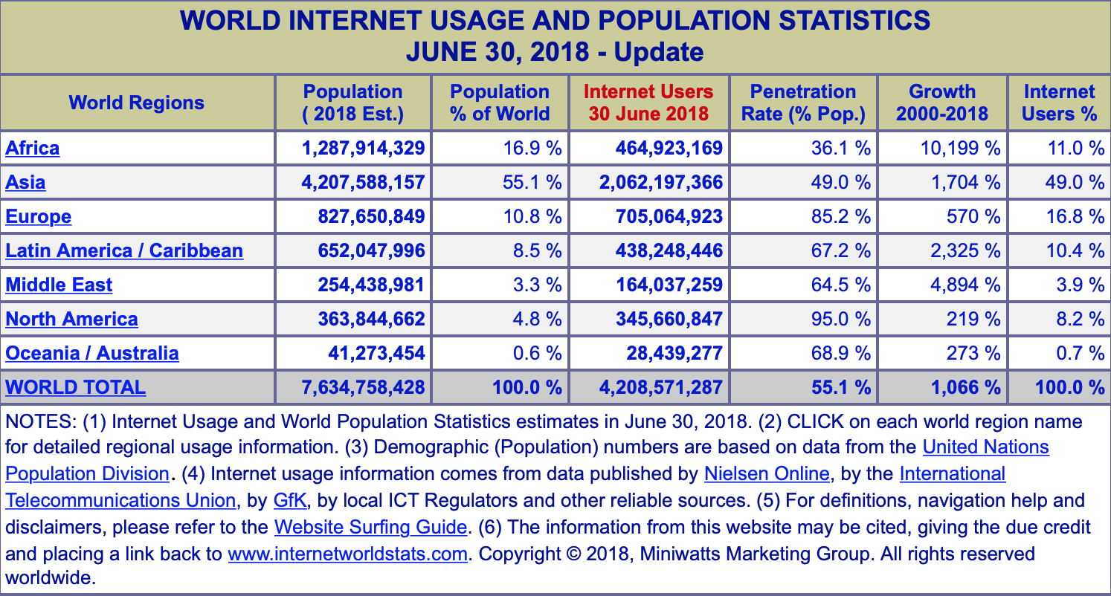
Internet Users in the World as of June 2018 https://www.internetworldstats.com/stats.htm

Slide 22
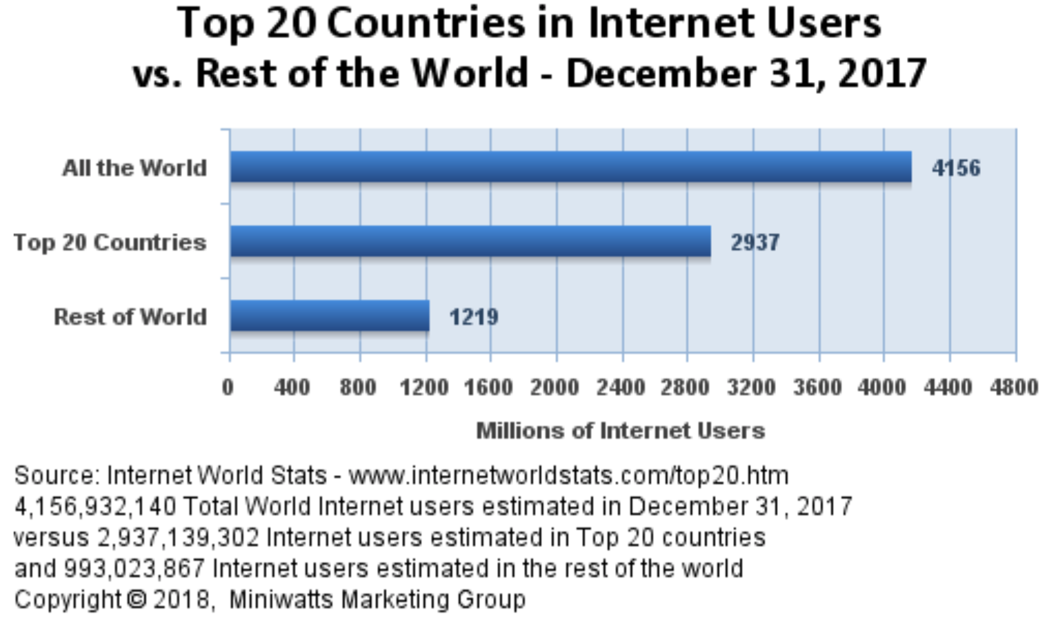
Top 20 Internet Countries – 2017
With the Highest Number of Internet Users
http://www.internetworldstats.com/top20.htm

Slide 23
Top 20 Internet Countries – 2018
With the Highest Number of Internet Users
http://www.internetworldstats.com/top20.htm

Slide 24
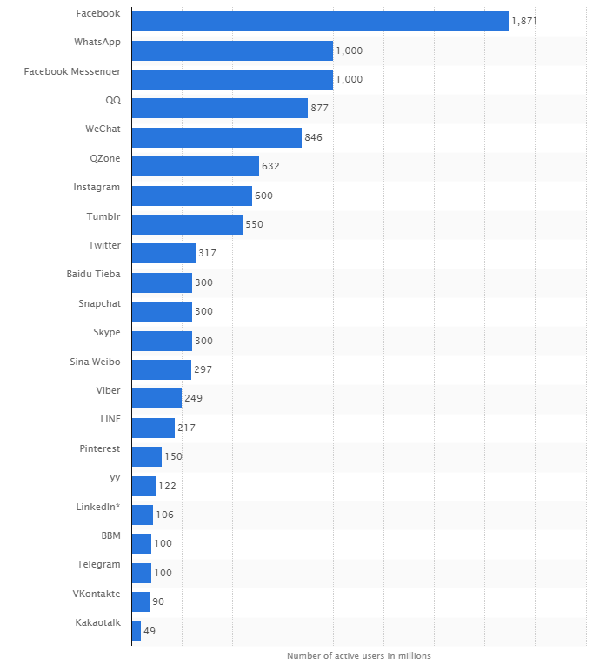
MOST USED SOCIAL APPS in 2017. World Economic Forum.
https://assets.weforum.org/editor/MWRs37B_A5a5INGyQwxmijU74_iHeD_EUYSf676cQ88.PNG

Slide 25

WEB 1.0 AND WEB 2.0

Slide 26
WEB 2.0
Internet services that foster collaboration and information sharing
Peer production: Collaboration between users to create content, products, and services.
Leveraged to create open source software that supports Web 2.0.
Collaborative consumption: Participants share access to products and services, rather than having ownership.

Slide 27
WEB 1.0 AND WEB 2.0
WEB 1.0 | WEB 2.0
Domain name speculation Publishing Content management systems Directories (taxonomy) Britannica Online, Encarta Personal websites Ofoto Instant messaging, SMS Monster.com RealNetworks Yellowpages.com Travelocity Vonage Catalogs Expedia, Orbitz | Search engine optimization and fans Participation Wikis Tagging (“folksonomy”) Wikipedia Blogging, Status updates, Link Sharing Instagram, Flickr, Facebook, Twitter, Facebook, SnapChat, WhatsApp LinkedIn YouTube Yelp TripAdvisor Skype Pinterest Airbnb, Uber, RelayRides

Slide 28
What is Web 3.0?

Slide 29
What is Web 3.0?
“Web 3.0, a phrase coined by John Markoff of the New York Times in 2006, refers to a supposed third generation of Internet-based services that collectively comprise what might be called ‘the intelligent Web’ — such as those using semantic web, microformats, natural language search, data-mining, machine learning, recommendation agents, and artificial intelligence technologies — which emphasize machine-facilitated understanding of information in order to provide a more productive and intuitive user experience.”
Enabled by the convergence of key emerging technologies:
Ubiquitous Connectivity: broadband, mobile internet access, mobile devices
Network Computing: SaaS, web services, distributed computing
Open APIs, protocols, data formats, open-source platforms, open identity, open data
Semantic web technologies, distributed databases, intelligent applications

Slide 30
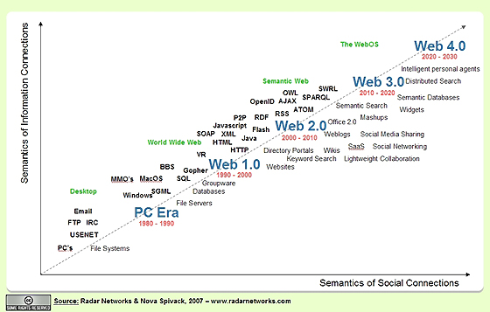
Web Evolution

Slide 31
SOCIAL MEDIA TOOLS

Slide 32
SOCIAL MEDIA TOOLS
Service | KEY USES | TECHNOLOGY PROVIDERS
Blogs | Share ideas, obtain feedback, mobilize a community | Blogger (Google),WordPress, Tumblr
Wikis | Create a common knowledge base | Socialtext, PBWorks, Jive, Google Sites, MS SharePoint, Atlassian, Apple OS X Server
Electronic social network | Discover and reinforce affiliations, identify experts, message individuals or groups, visually share media | OPEN/PUBLIC: Facebook, LinkedIn ENTERPRISE/PRIVATE PLATFORMS: Ning, Lithium, SelectMinds, LiveWorld, IBM Lotus Connections, Salesforce.com, Socialtext

Slide 33
SOCIAL MEDIA TOOLS
Service | KEY USES | TECHNOLOGY PROVIDERS
Microblogging | Distribute time-sensitive information, share opinions, virally spread ideas, run contests and promotions, solicit feedback, provide customer support, track commentary on firms/products/issues, organize protests | OPEN/PUBLIC: Facebook, Twitter ENTERPRISE PLATFORMS: Slack, HipChat, SocialText Signals, Yammer, Salesforce.com (Chatter)
Messaging Services | Communicate with individuals or groups of users using short-format text, graphics, and video. Most messaging is done using mobile devices. | TYPES OF SERVICE: Photo SMS Replacement Enterprise Anonymous
Question & Answer Sites | Knowledge sharing, discovery, learning, reputation building. | Quora, Stack Exchange/Stack Overflow

Slide 34
BLOGS
Online journal entries usually presented
in a reverse chronological order
Long tail: Phenomenon whereby firms can make money by offering a near-limitless selection of contents and products.
Trackbacks: Links in a blog post that refer readers back to cited sources.
Blog rolls: List of a blogger’s favorite blogs.
Corporations use blogs to distribute ideas and gather feedback from the public.

Slide 35
BLOGS: KEY FEATURES
Immediate and unfiltered publication. The ability to reach the public without limits on publication size and without having posts filtered, edited, or cut by the mainstream media.
Ease of use. Creating a new post usually involves clicking a single button.
Comment threads. Readers can offer comments on posts.
Reverse chronology. Posts are listed in reverse order of creation, making it easy to see the most recent content.
Persistence. Posts are maintained indefinitely at locations accessible by permanent links.
Searchability. Current and archived posts are easily searchable.
Tags. Posts are often classified under an organized tagging scheme.
Trackbacks. Allows an author to acknowledge the source of an item in their posts, which allows bloggers to follow the popularity of their posts among other bloggers.

Slide 36
WIKIS
Website, that can be modified by anyone directly within a web browser, that serves as a shared knowledge repository
Acts as a collective corporate memory that is vital for sharing skills, learning, and preserving expertise.
Users can make changes to existing content and easily create new content.
Roll back: Ability to revert a wiki page to a prior version.
Useful for restoring earlier work in the event of a posting error, inaccuracy, or vandalism.

Slide 37
WIKIS: KEY FEATURES
All changes are attributed, so others can see who made a given edit.
A complete revision history is maintained so changes can be compared against prior versions and rolled back as needed.
Automatic notification and monitoring of updates.
All pages in a wiki are searchable.
Specific wiki pages can be classified under an organized tagging scheme.

Slide 38
SOCIAL NETWORK
Online community that allows users to establish a personal profile and communicate with others
Feed - Powerful feature of social networks:
Provides a timely list of the activities of and public messages from people, groups, and organizations that an individual has an association with.
Viral: Information or applications that spread rapidly between users.

Slide 39

SOCIAL NETWORKS: KEY FEATURES
Detailed personal profiles
Affiliations with groups (e.g., alumni, employers, hobbies, fans, health conditions, causes); with individuals (e.g., specific “friends”); and with products, firms, and other organizations
Private messaging and public discussions
Media sharing (text, photos, video)
Discovery-fueling feeds of recent activity among members (e.g., status changes, new postings, photos, applications installed)

Slide 40
CORPORATE USE OF SOCIAL NETWORKS
Social networks have become organizational productivity tools.
Firms implement their own, internal social network platforms that they hope are more secure and tailored to firm needs.
These networks have replaced the traditional employee directory.
They’re important since a large percentage of employees regularly work from home or client locations.
Firms are setting up social networks for customer engagement and mining these sites for customer ideas, innovation, and feedback.
Doctors are using social networking to more quickly and more accurately diagnose patients
Patients are using social networks to connect with and help others suffering with similar ailments.

Slide 41
SOCIAL NETWORKS AND HEALTH CARE
Sermo is a social network for physicians (which means conversation in Latin)
Assist physicians gain peer opinion on confounding cases or other medical questions. Most doctors receive responses within an hour and a half of posting, and most cases are solved within twenty-four hours.
Eighty-five percent of posting physicians say they received information they were looking for.
More than 340,000 doctors in the US and UK are Sermo members, although a much smaller percentage is active on the site.
Member physicians are screened and verified to maintain the integrity of the service.
Sermo posts can also send valuable warning signals on issues such as disease outbreaks or unseen drug side effects.
Doctors have also used the service to rally against insurance company policy changes.

Slide 42
SOCIAL NETWORKS AND HEALTH CARE
PatientsLikeMe (PLM) offers a social network empowering chronically ill patients across a wide variety of disease states.
The firm’s “openness policy” is in contrast to privacy rules posted on many sites and encourages patients to publicly track and post conditions, treatments, and symptom variation over time, using the site’s sophisticated graphing and charting tools.
The goal is to help others improve the quality of their own care by harnessing the wisdom of crowds.

Slide 43
TWITTER AND THE RISE OF MICROBLOGGING
Microblogging: Short-message blogging, made through a mobile device.
Twitter is a microblogging service that allows users to post via the Web, SMSA text messaging, or a variety of third-party desktop and smartphone applications.
Tweet: Twitter post, limited to 140, now 280, characters.
Hash tags: Method for organizing tweets where keywords are preceded by the # character.
Firms leverage Twitter for:
Real-time promotion
Customer response, engagement, and support
Gathering feedback and up-to-date information
Time-sensitive communication

Slide 44

Prediction Markets and the Wisdom of Crowds
Wisdom of crowds: Idea that a group of individuals will collectively have more insight than a single or small group of trained professionals.
Consists of untrained amateurs.
Prediction market: Polling a diverse crowd and aggregating opinions in order to form a forecast of an eventual outcome.

Slide 45
THE “SMART” CROWD
Diverse
Decentralized
Offer a collective verdict
Independent

Slide 46
CROWDSOURCING
Taking a job traditionally performed by a designated agent and outsourcing it to an undefined, generally large, group of people in the form of an open call
Leveraged by several public markets:
For innovation
As an alternative to standard means of production
Nine of the world’s top ten brands have engaged in some form of crowdsourcing.
Not all crowdsourcing is financially motivated.
Some benefit by helping to create a better service.

Slide 47
MONITORING: Online reputation management
Tracking and responding to online mentions of a product, organization, or individual
Many tools exist for monitoring social media mentions of an organization, brands, competitors, and executives.
Social media are easy to adopt and potentially easy to abuse.

Slide 48
Chapter 10
The sharing economy, collaborative consumption, and efficient markets through tech

Slide 49
What is the Sharing Economy?

Slide 50
The Sharing Economy
Technology allows product and service providers to connect with consumers.
Offers far greater reach and efficiency than traditional markets.
Generation of ‘citizen suppliers.’
Product owners become providers of rentals.
New class of micro-entrepreneurs providing personal services.

Slide 51
What is Collaborative Consumption?

Slide 52
What is Collaborative Consumption?
Categories of products are collaboratively consumed.
An individual takes possession of an item for a period of time and then returns it for use by others.
Internet-enabled market makers.
Roots in eBay and CraigsList.

Slide 53
Collaborative Consumption
Examples of firms:
eBay, CraigsList
Zilok, RentTheRunway, Chegg
Etsy, CustomMade
oDesk, eLance, Crowdspring
Angie’s List, TaskRabbit
Drizly
Uber, Lyft, ZipCar
LiquidSpace, ShareDesk
HomeAway
LendingClub, KickStarter, GoFundMe

